Slide 1
Mastering Blockchain Third Edition
Chapter 9, Alternative Coins

Slide 2
Outline
Introducing altcoins
Theoretical foundations
Difficulty adjustment and retargeting algorithms
Bitcoin limitations
Extended protocols on top of Bitcoin
Development of altcoins

Slide 3
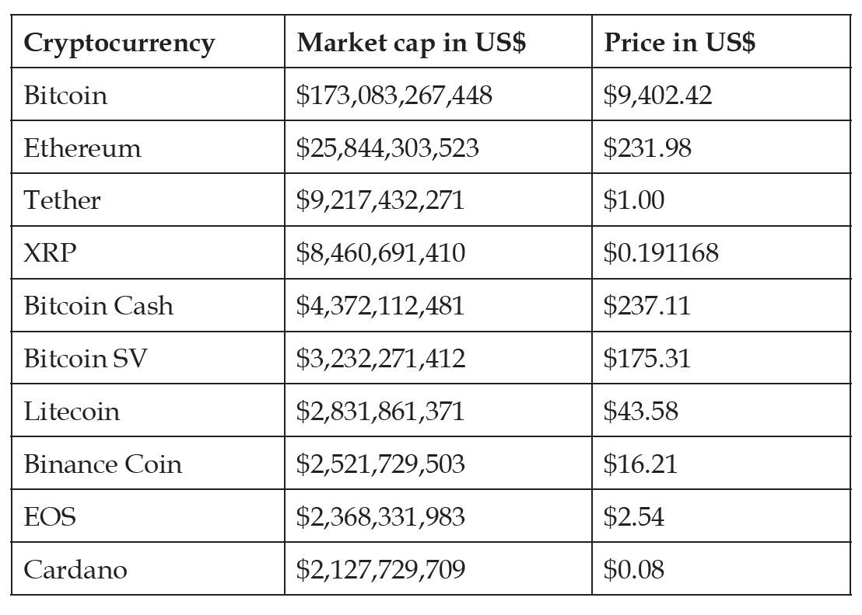
Altcoins
‘Altcoins’ is a term used to describe coins other than the original electronic cash bitcoin.
Bitcoin and some other top currencies by market cap. Figures based on mid-2020 statistics

Slide 4
Bitcoin power consumption
Bitcoin’s Proof of Work (PoW) consensus mechanism has several drawbacks, particularly extremely high energy requirements.
This is the main reason why alternatives PoW to were proposed, such as Proof of Stake (PoS).
Energy consumption by country – Bitcoin at No. 46.

Slide 5
Difficulty adjustment and retargeting algorithms
PoW algorithms use difficulty adjustment and retargeting algorithms, which are simple arithmetic formulas that help adjust the difficulty of solving the PoW problem:
Bitcoin
T = Time previous * time actual / 2016 * 10 min
Kimoto Gravity Well
KGW = 1 + (0.7084 * pow((double(PastBlocksMass)/double(144)), -1.228))
Dark Gravity Wave
2222222/(((Difficulty+2600)/9)^2)
DigiShield
New difficulty = (previous difficulty) x SQRT [ (150 seconds) / (last solve time) ]
MIDAS
A more complex algorithm for difficulty adjustment

Slide 6
Bitcoin limitations
Privacy and anonymity
To address such issues, various proposals have been made:
Mixing protocols
Inherent anonymity
CoinSwap
TumbleBit
Dandelion

Slide 7
Extended protocols on top of Bitcoin
Colored coins: developed to represent digital assets on the Bitcoin blockchain. Coloring a bitcoin refers to updating it with some metadata representing a digital asset
Counterparty: another service that can be used to create custom tokens that act as a cryptocurrency and can be used for various purposes, such as issuing digital assets on top of the Bitcoin blockchain

Slide 8
Development of altcoins
The following are some required parameters, or parameters to be tweaked, if forking from another code base:
Consensus algorithms
Difficulty adjustment algorithms
Inter-block time
Block rewards
Reward halving rate
Block size and transaction size
Interest rate
Coinage
Total supply of coins

Slide 9
Exercise
Consider what parameters were changed in order to create the Litecoin blockchain from Bitcoin.

Slide 10
Summary
In this presentation, we considered:
Several altcoins in detail
Some limitations of Bitcoin that led to the development of altcoins
Difficulty adjustment algorithms
Extended Bitcoin protocols and altcoin development parameters

